Slide 1
DM2004 Online Advertising and Analytics
Google Analytics

Slide 2
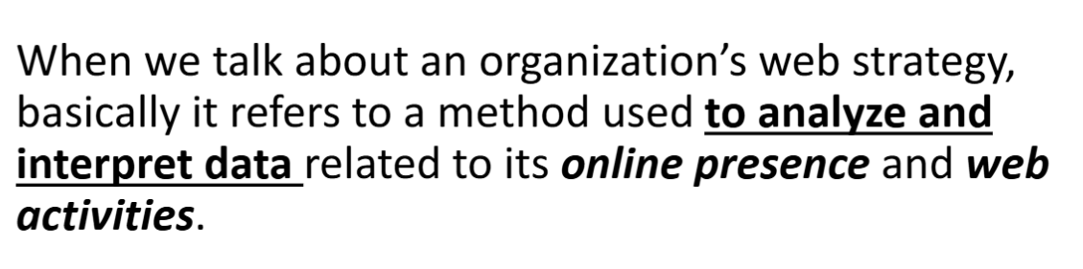
The Purpose of Web Analysis

Slide 3
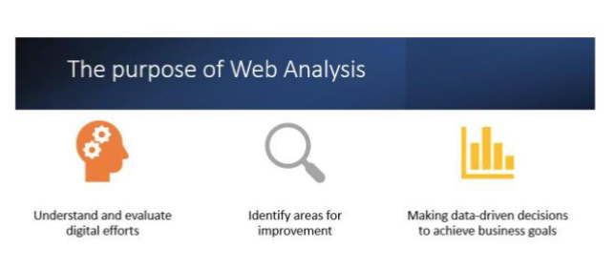

Slide 4
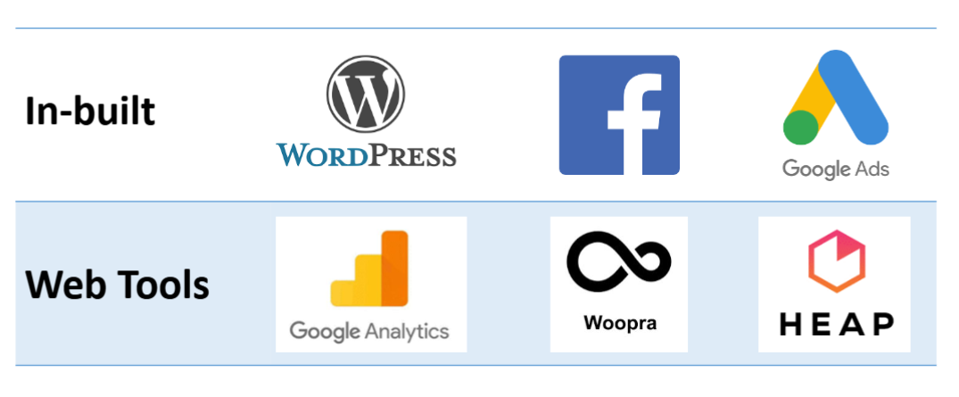
Technology in Analytics Tools (Platforms with Built-in Analytics)

Slide 5
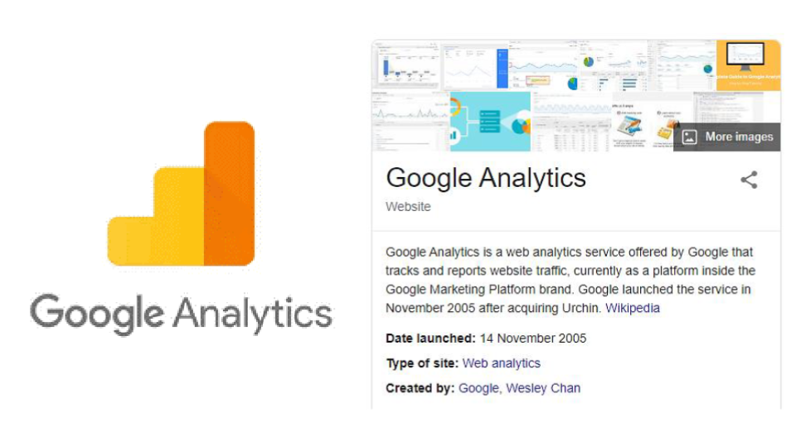
Technology in Analytics Tools (Platforms with Built-in Analytics)

Slide 6
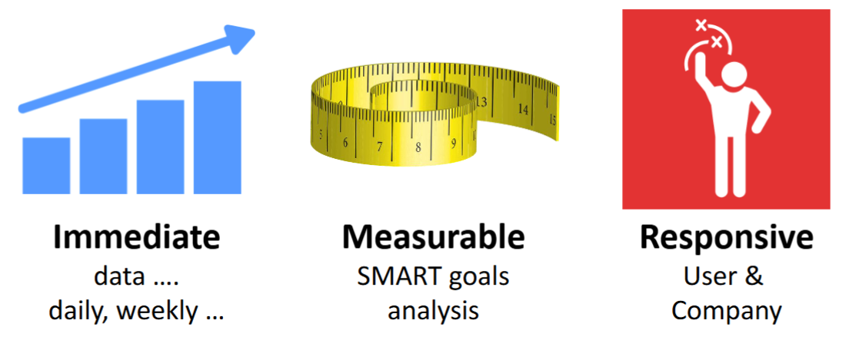
Technology in Analytics Tools (Value of Digital Data)

Slide 7
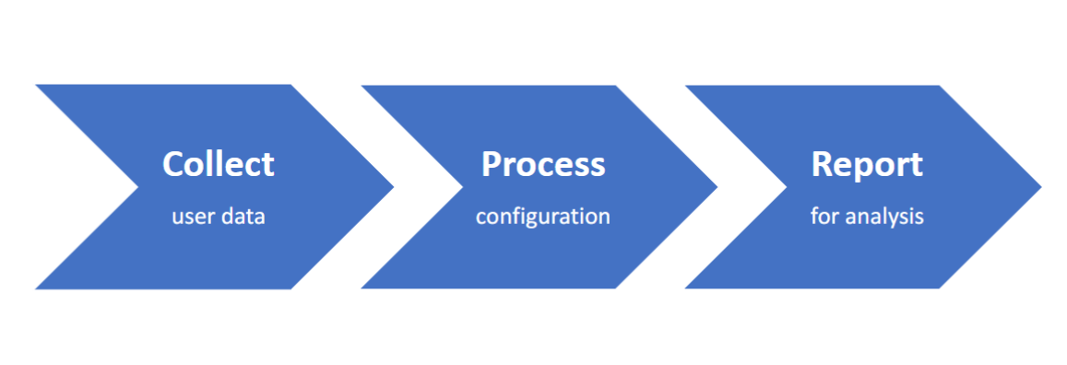
Technology Trend in Google Analytics (How Google Analytics Works)

Slide 8
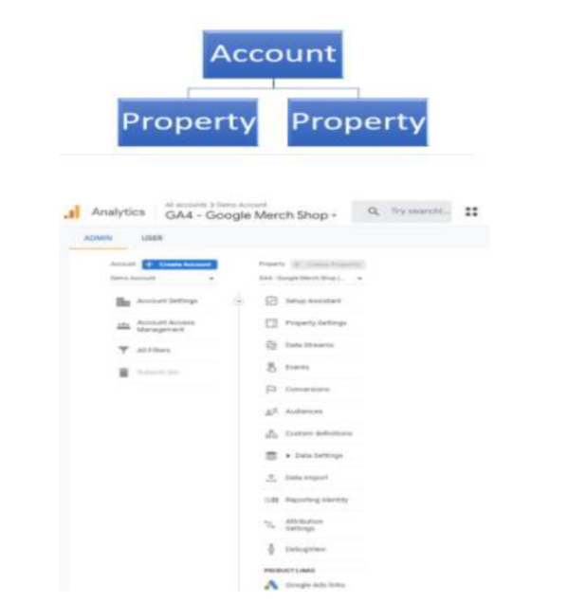
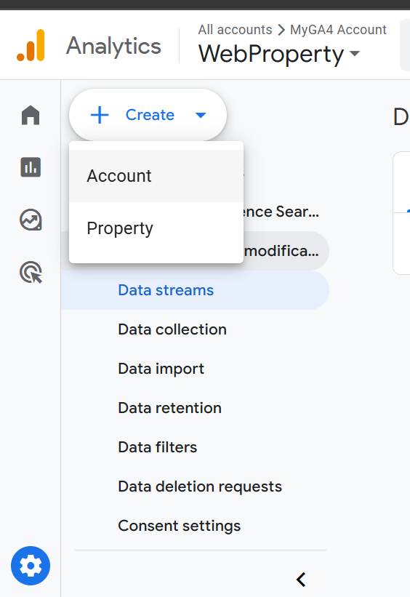
Technology Trend in Google Analytics (Google Analytics Account Structure)

Slide 9
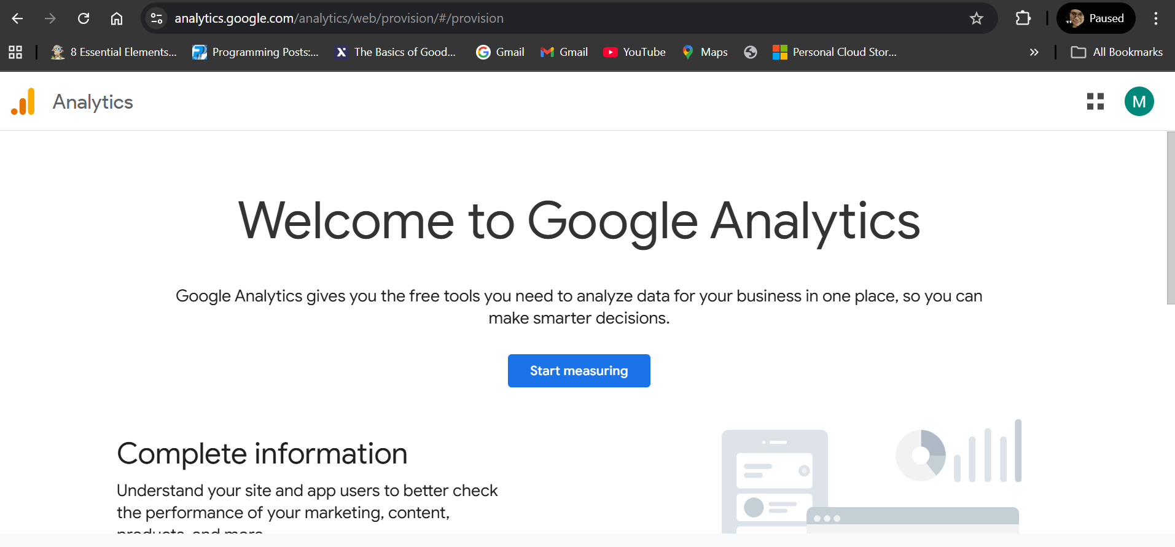
Technology Trend in Google Analytics (Set-up Google Analytics Account)

Slide 10
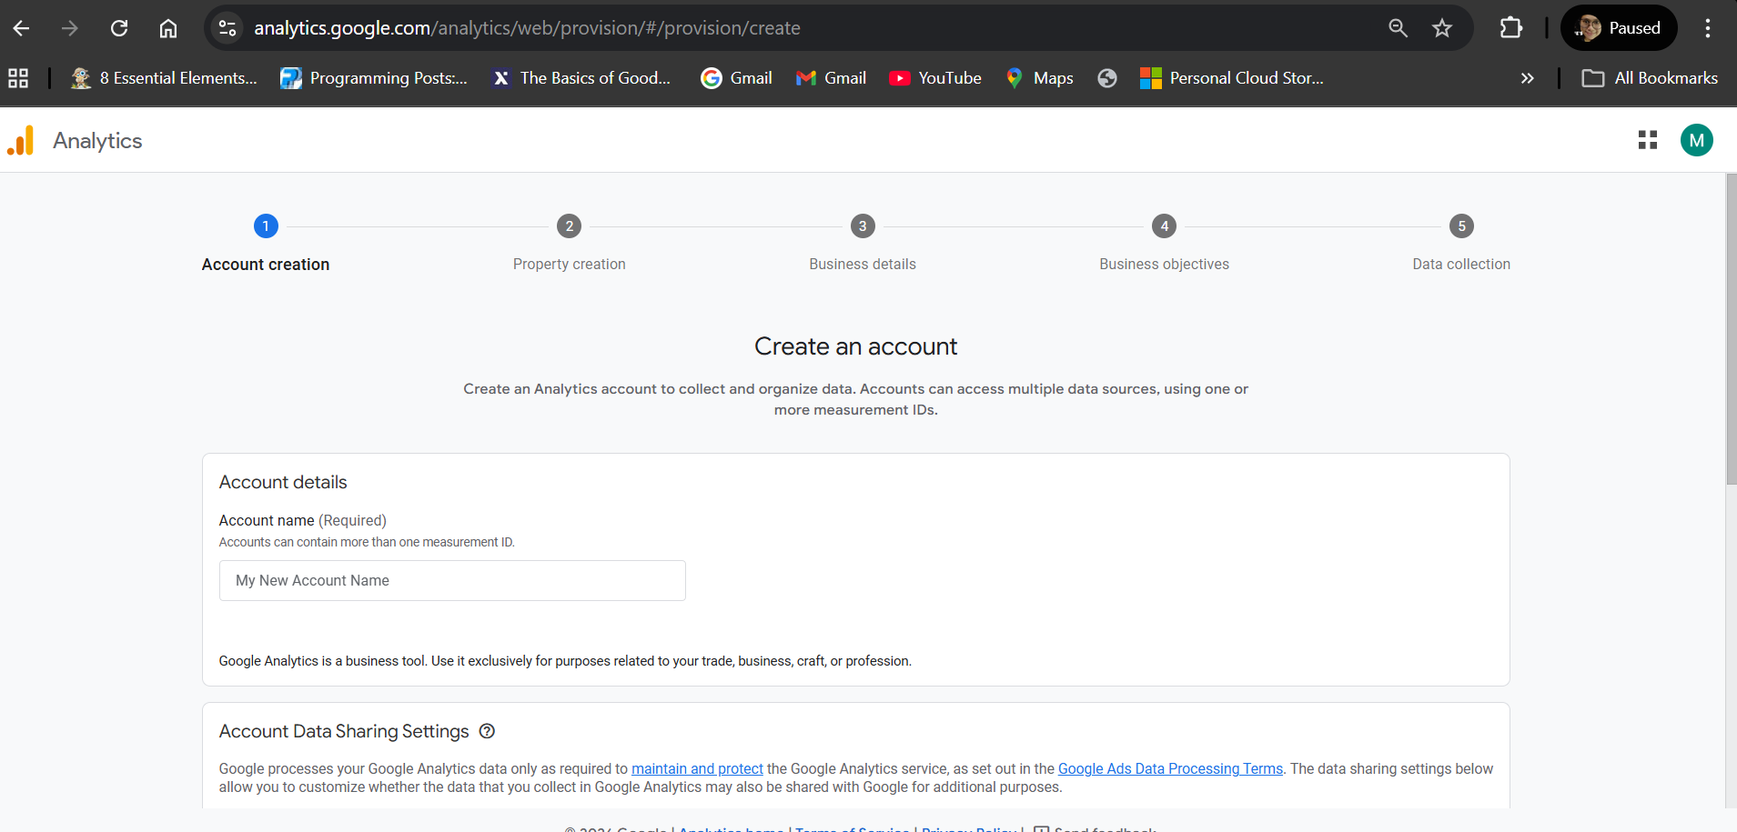
Technology Trend in Google Analytics (Set-up Google Analytics Account)

Slide 11
Demo the Setting-Up of Google Analytics Account

Slide 12
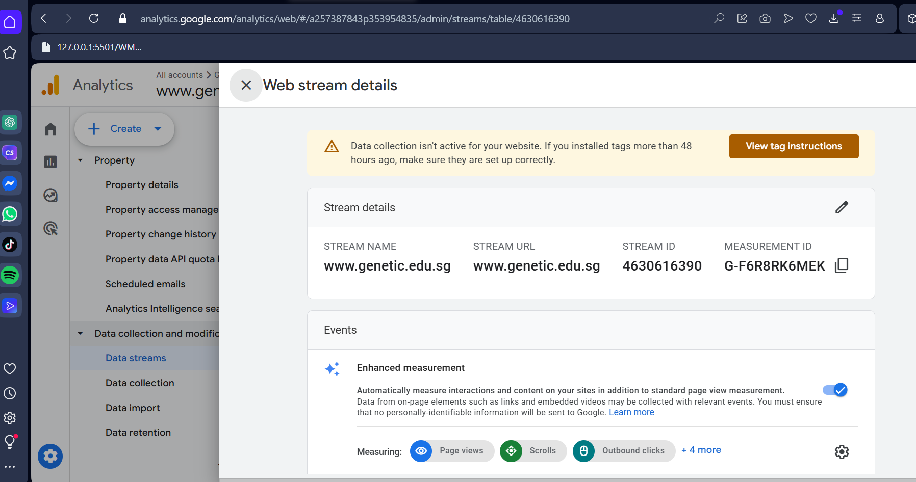
Google Tag

Slide 13
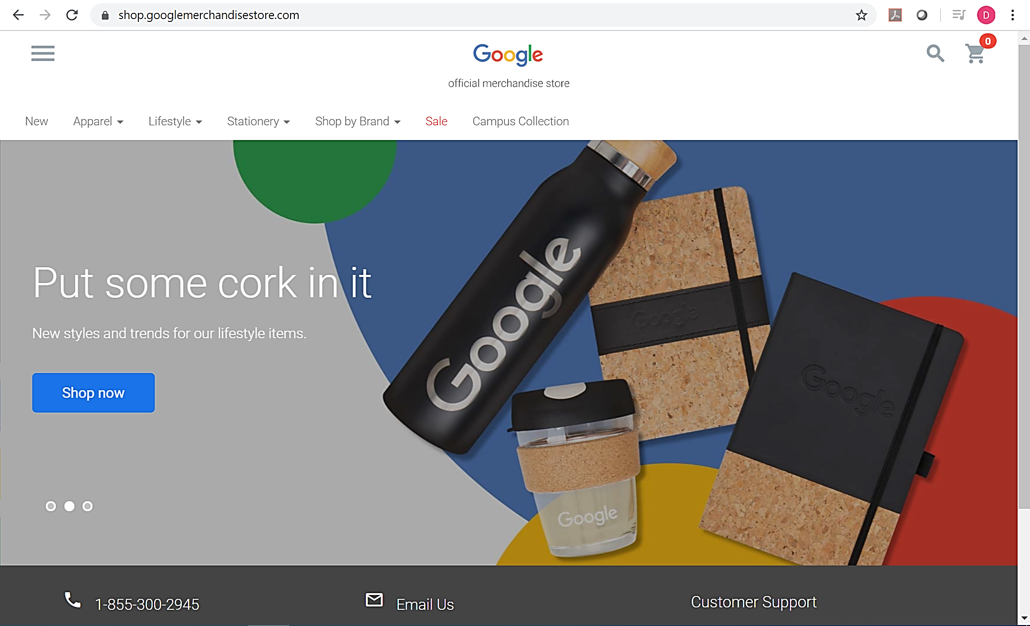
Data Analytics Measurement Strategy

Slide 14
Demo – Google Merchandise Store
Data Analytics Measurement Strategy
https://analytics.google.com/analytics/web/demoAccount
This demo account shows live data from the Google Merchandise Store

Slide 15
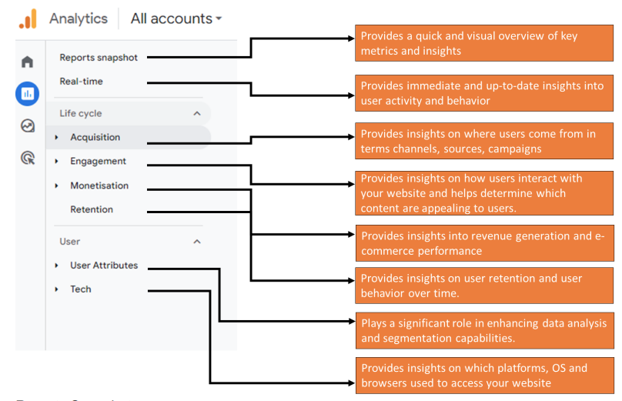
Report Format

Slide 16
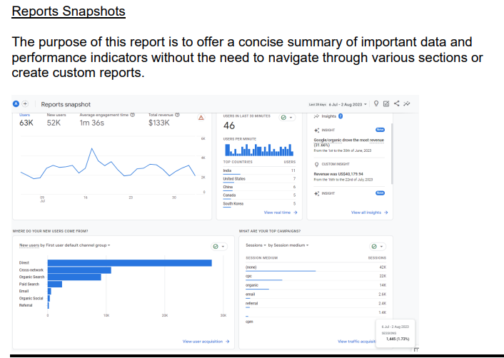
Report Format

Slide 17
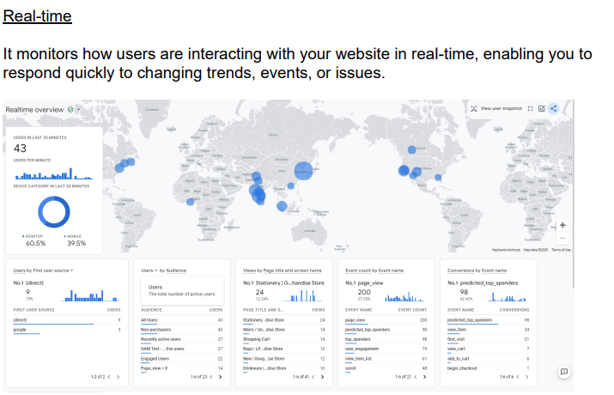
Report Format

Slide 18
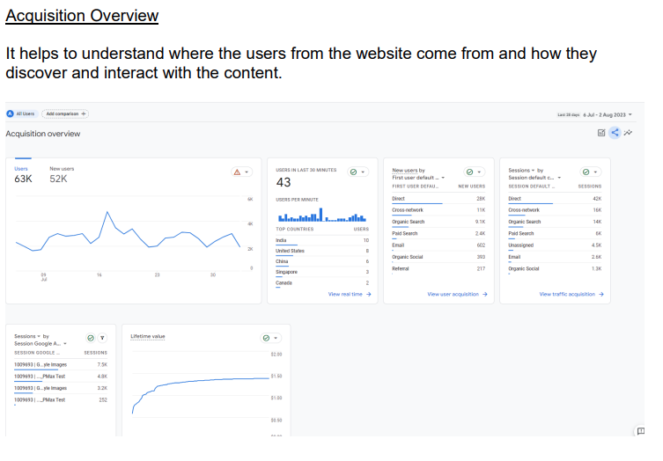
Report Format

Slide 19
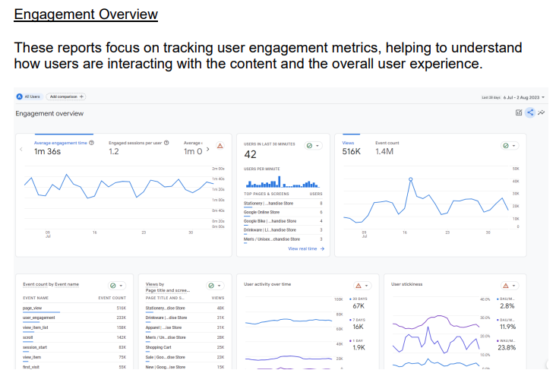
Report Format

Slide 20
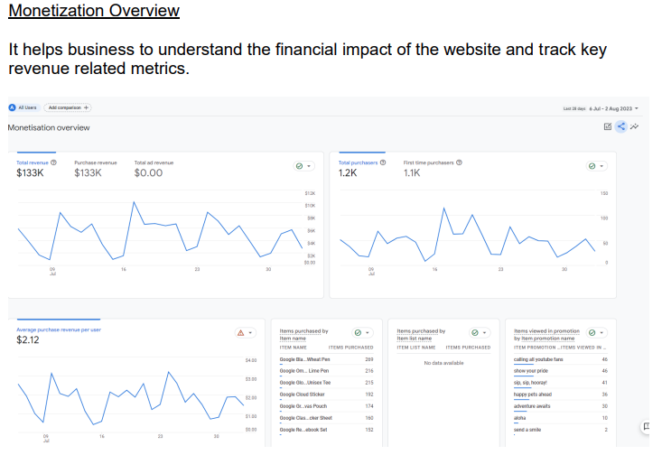
Report Format

Slide 21
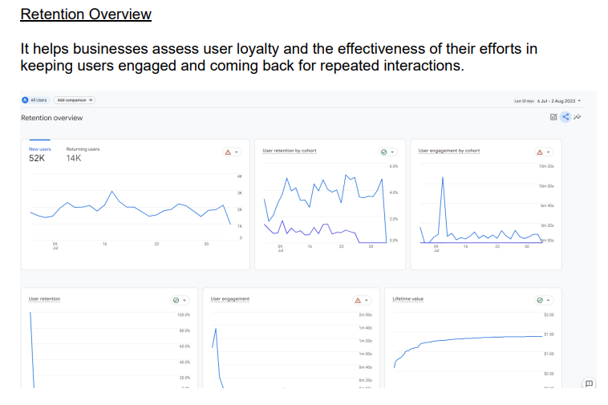
Report Format

Slide 22
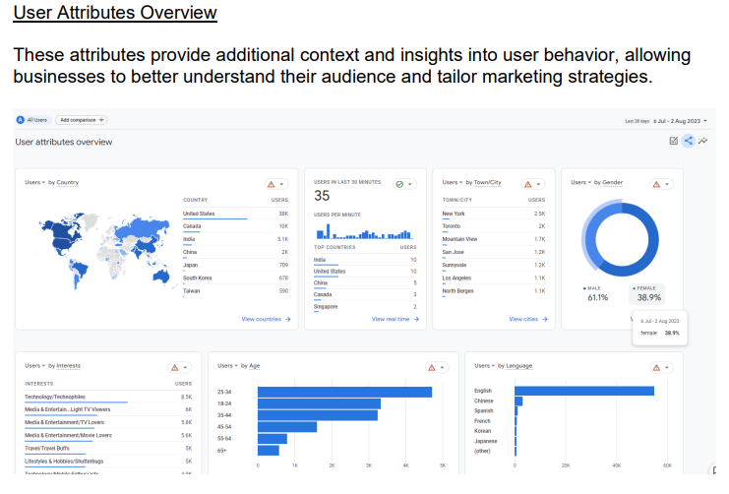
Report Format

Slide 23
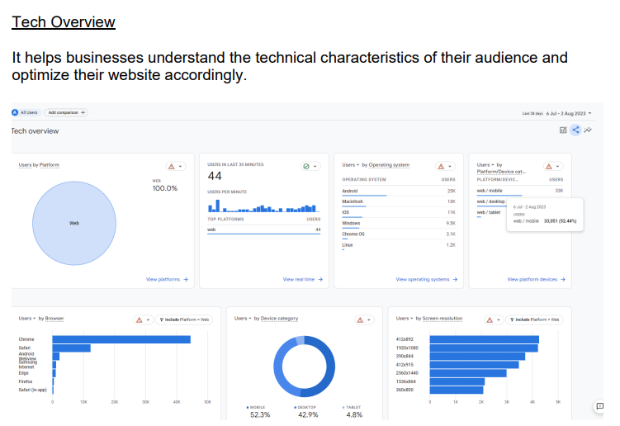
Report Format

Slide 24
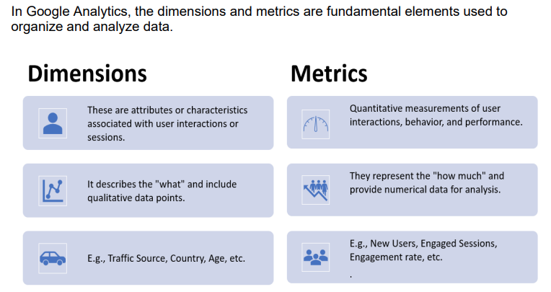
Dimensions and Metrics

Slide 25
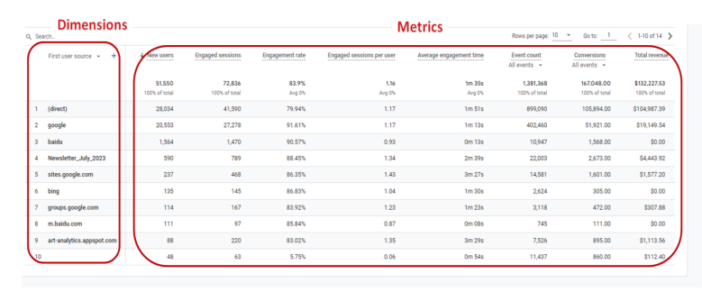
3.3 Dimensions and Metrics

Slide 26
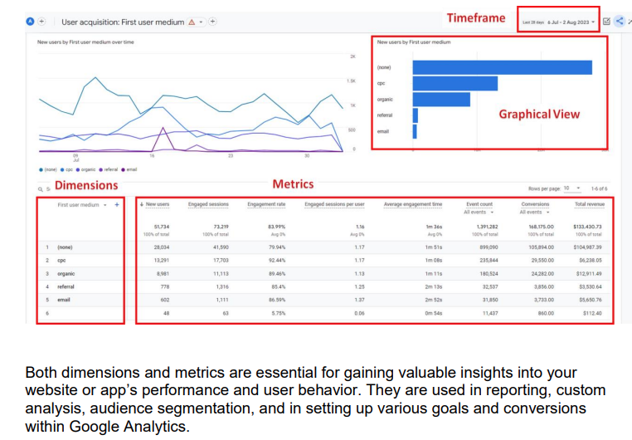
Dimensions and Metrics

Slide 27
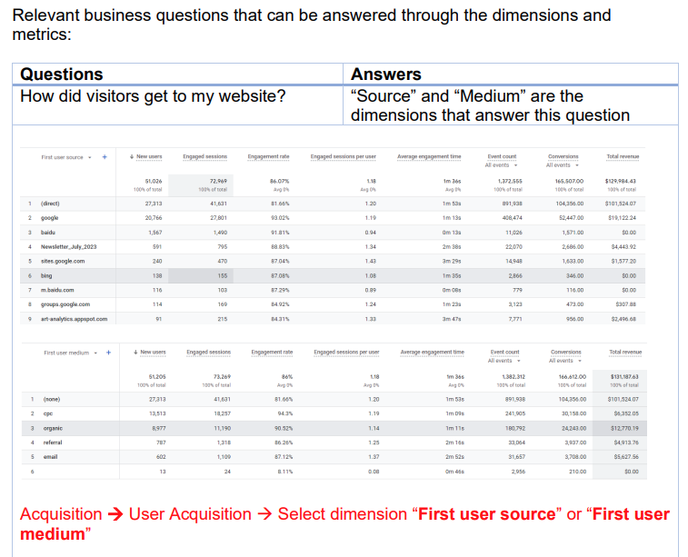
Dimensions and Metrics

Slide 28
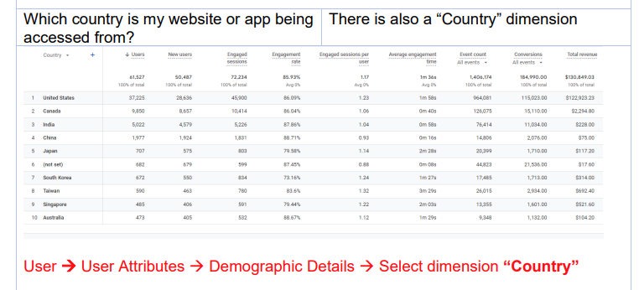
Dimensions and Metrics

Slide 29
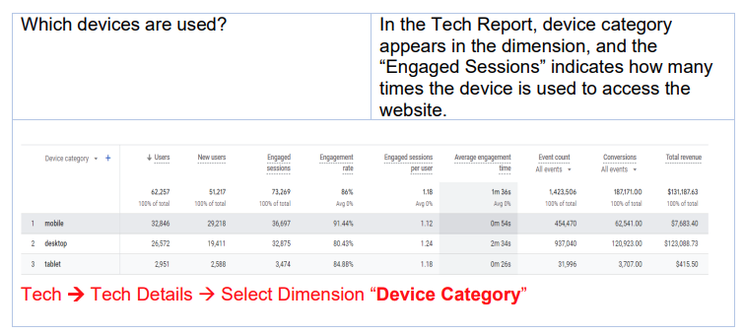
Dimensions and Metrics

Slide 30
Dimensions and Metrics
DEMO the following:
Date Selection
Report → Realtime
Acquisition → Overview
Acquisition→ User Acquisition
Acquisition → Traffic Acquisition
Engagement → Overview
Engagement → Events
Engagement → Conversions
Engagement → Landing Page

Slide 31
Dimensions and Metrics
DEMO the following:
Engagement → Pages and Screens
Monetization → Overview
Monetization → E-commerce purchases
Monetization → User purchase journey
Monetization → Promotions
Retention
User Attributes → Overview
User Attributes → Demographic Details
Technology → Overview
Technology → Technology Details

Slide 32
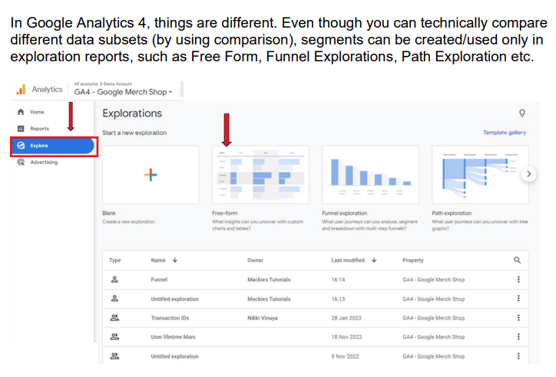
4.1 What is Segmentation?
About segments - Analytics Help (google.com)

Slide 33
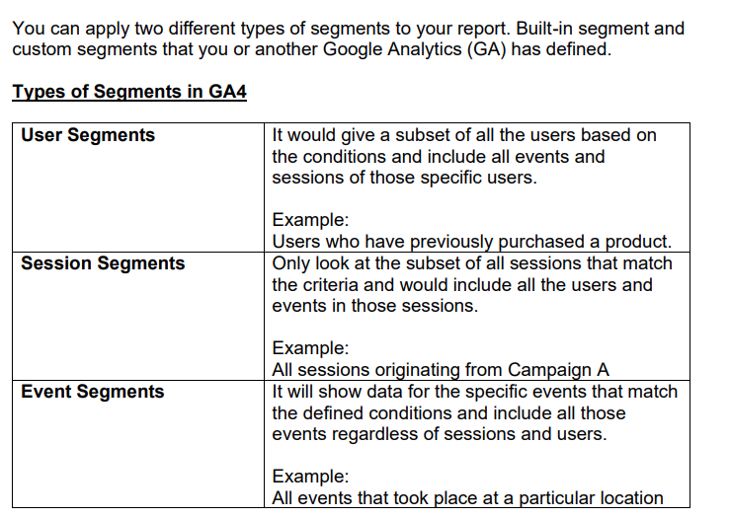
System and Custom Segment

Slide 34
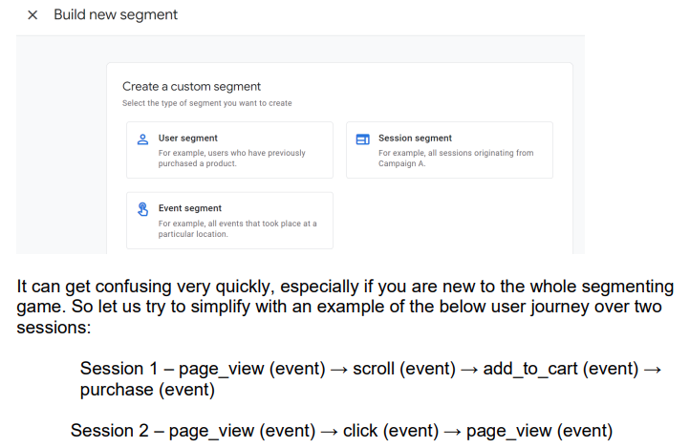
System and Custom Segment

Slide 35
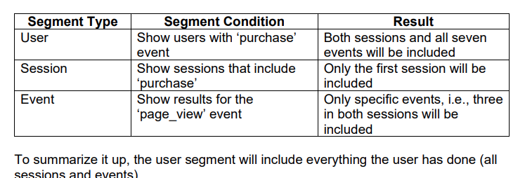
System and Custom Segment

Slide 36
System and Custom Segment
Demo on how to create and manage segments in GA4

Slide 37
4.3 Analyzing Growth & Churn
Growth Rate | The percentage change of a specific measurable variable over a specific time period; e.g., increase in users
Churn Rate | The percentage of individual leaving a group over a specific time period; e.g., loss in subscription

Slide 38
Rates Calculation
Current Value – Past Value
X 100%
Past Value
+
-
Growth
Churn

Slide 39



4.4 Linking Google Services

Slide 40
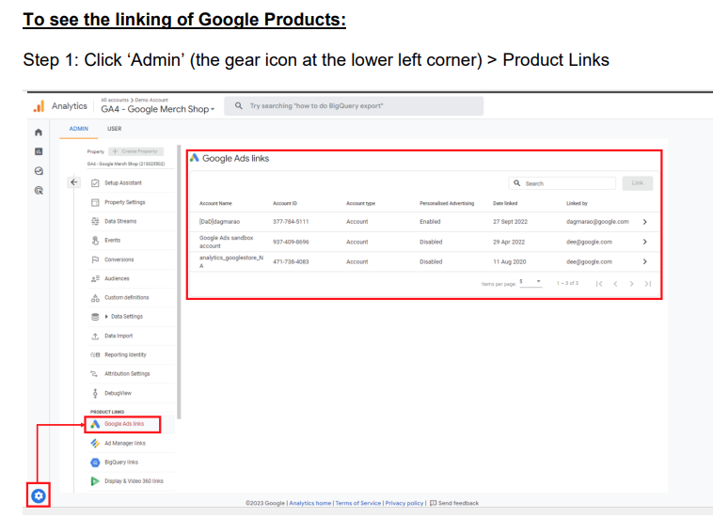
Linking Google Services

Slide 41
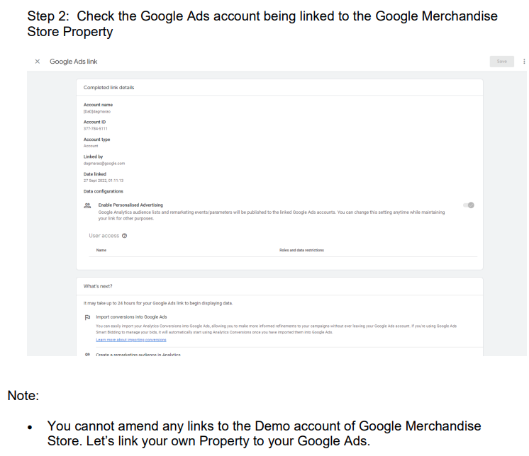
Linking Google Services

Slide 42
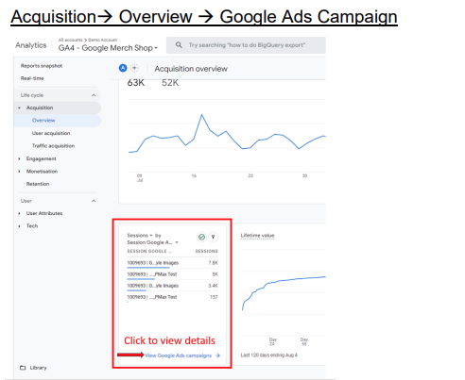
Linking Google Services

Slide 43
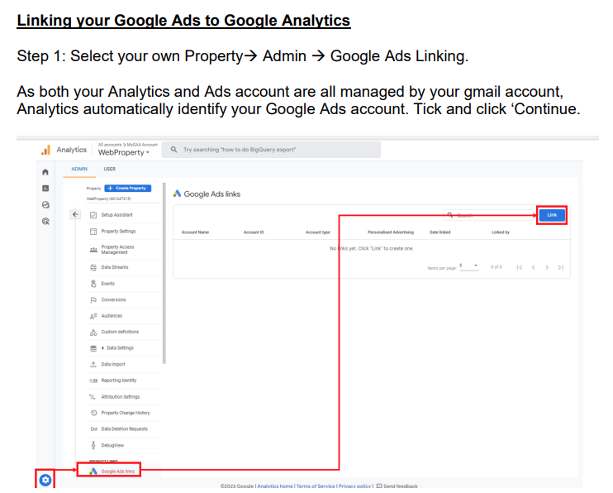
Linking Google Services

Slide 44
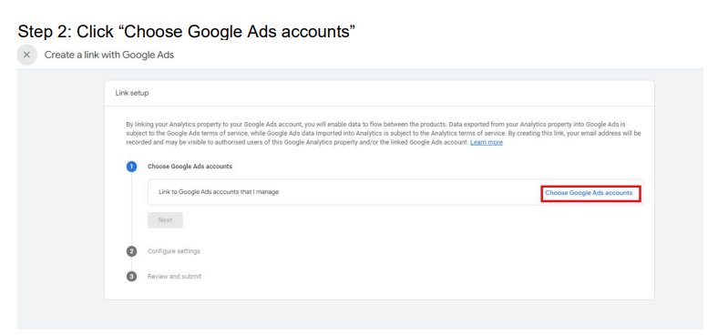
Linking Google Services

Slide 45
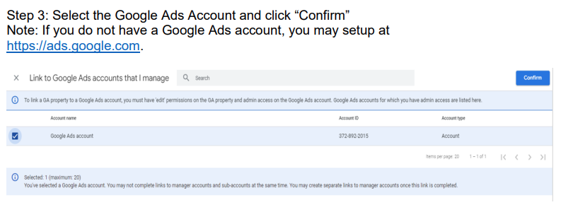
Linking Google Services

Slide 46
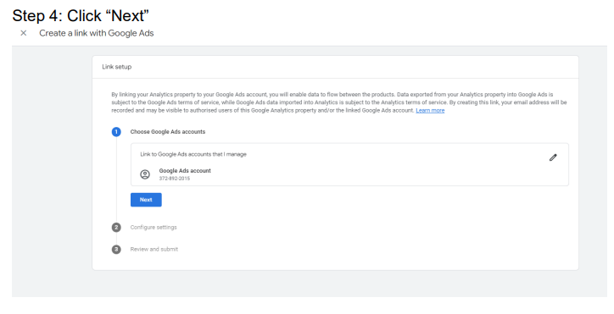
Linking Google Services

Slide 47
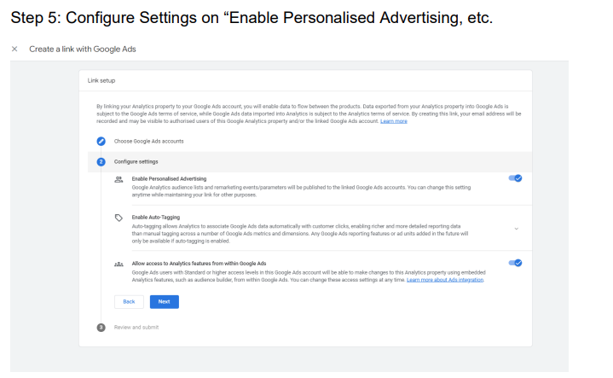
Linking Google Services

Slide 48
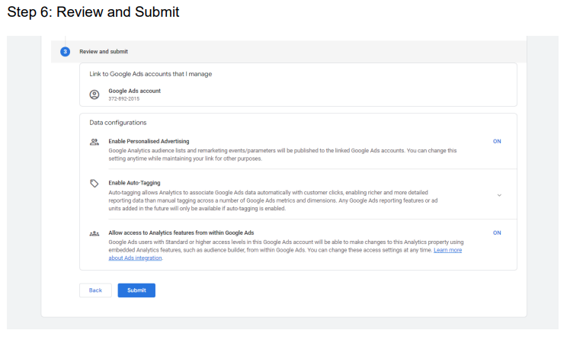
Linking Google Services

Slide 49
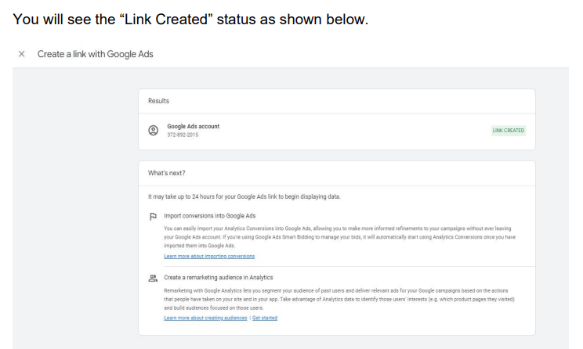
Linking Google Services

Slide 50
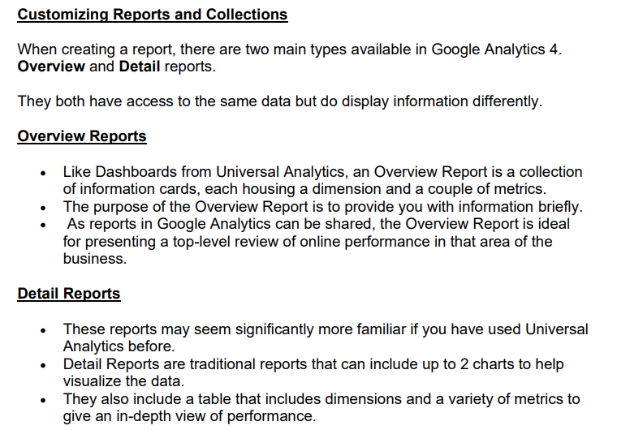
Dashboard and Custom Report

Slide 51
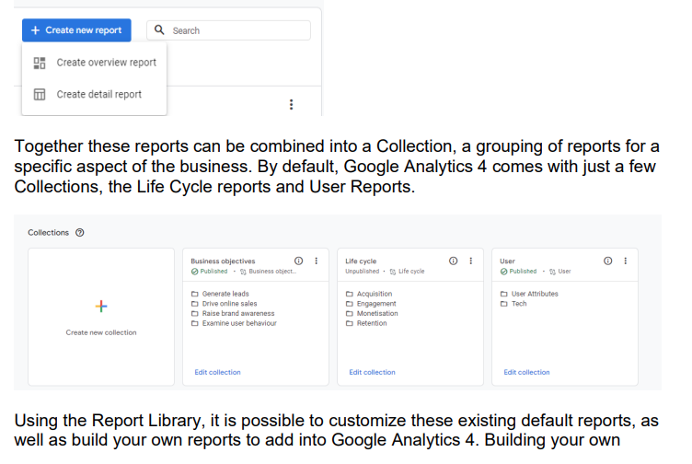
Dashboard and Custom Report

Slide 52
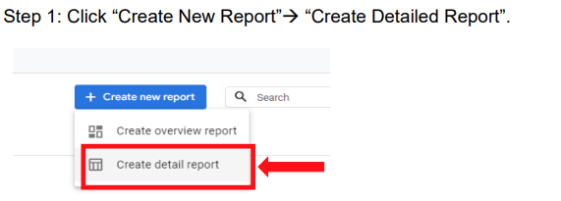
Dashboard and Custom Report (Creating a Detailed Report)

Slide 53
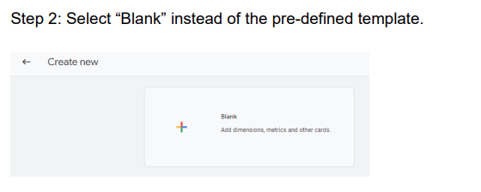
Dashboard and Custom Report (Creating a Detailed Report)

Slide 54
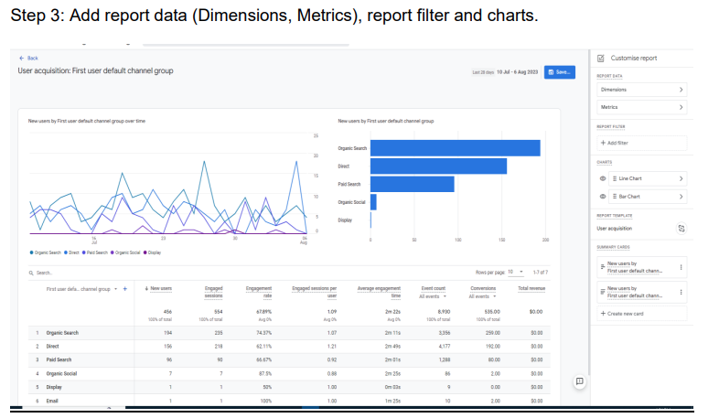
Dashboard and Custom Report (Creating a Detailed Report)

Slide 55
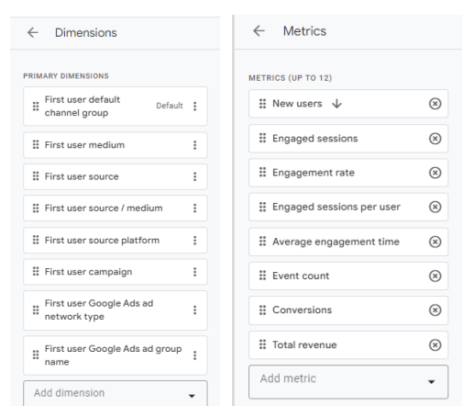
Dashboard and Custom Report (Creating a Detailed Report)

Slide 56
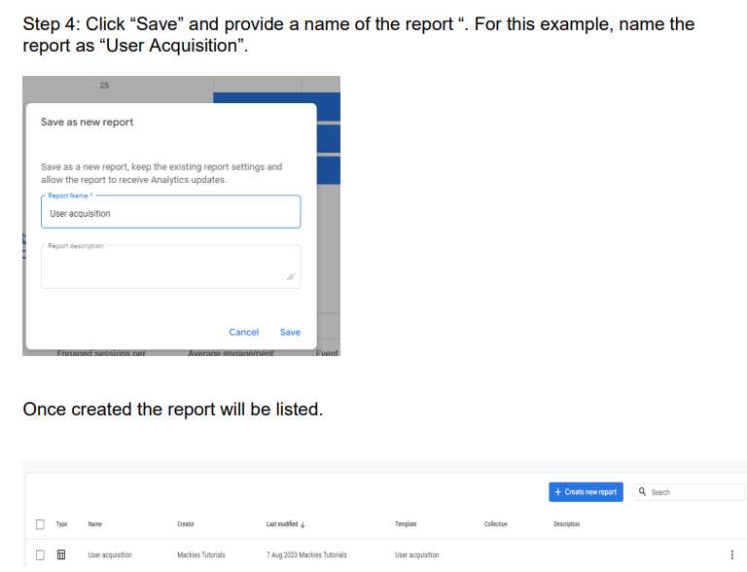
Dashboard and Custom Report (Creating a Detailed Report)

Slide 57
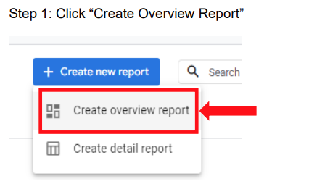
Dashboard and Custom Report (Creating an Overview Report)

Slide 58
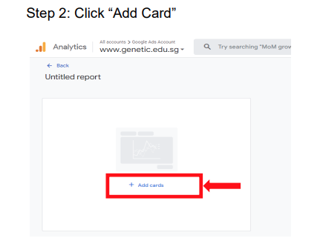
Dashboard and Custom Report (Creating an Overview Report)

Slide 59

Dashboard and Custom Report (Creating an Overview Report)

Slide 60

Dashboard and Custom Report (Creating an Overview Report)

Slide 61

Dashboard and Custom Report (Creating an Overview Report)

Slide 62

Dashboard and Custom Report (Creating a Collection)

Slide 63

Dashboard and Custom Report (Creating a Collection)

Slide 64

Dashboard and Custom Report (Creating a Collection)

Slide 65

Dashboard and Custom Report (Creating a Collection)

Slide 66

Dashboard and Custom Report (Creating a Collection)

Slide 67

Dashboard and Custom Report (Creating a Collection)

Slide 68


Dashboard and Custom Report (Creating a Collection)

Slide 69

Dashboard and Custom Report (Creating a Collection)

Slide 70

Dashboard and Custom Report (Creating a Collection)

Slide 71

5.1 Dashboard and Custom Report (GA4 Custom Exploration Report)

Slide 72

5.1 Dashboard and Custom Report (GA4 Custom Exploration Report)

Slide 73

Dashboard and Custom Report (GA4 Custom Exploration Report)

Slide 74

Dashboard and Custom Report (GA4 Custom Exploration Report)

Slide 75

Dashboard and Custom Report (GA4 Custom Exploration Report)

Slide 76

Dashboard and Custom Report (GA4 Custom Exploration Report)

Slide 77

Dashboard and Custom Report (GA4 Custom Exploration Report)

Slide 78

Dashboard and Custom Report (GA4 Custom Exploration Report)

Slide 79

Dashboard and Custom Report (GA4 Custom Exploration Report)

Slide 80

Dashboard and Custom Report (GA4 Custom Exploration Report)

Slide 81
Practice Exercise: Creating Reports & Collection
Create one (1) Overview Report (E.g., users → by Audience, users→ by Age, Conversions by Country, etc.)
Create two (2) Detailed Report (E.g., User Acquisition, Traffic Acquisition, Conversions, etc.)
Create a new Collection Adding 1 overview report and the 2 detailed reports.

